Slide 1
Phase-field multiphysics simulation with the User Element (UEL) subroutine in Abaqus/Standard
Nguyen Xuan Binh, Junhe Lian*
Aalto University, Finland
Corresponding author: junhe.lian@aalto.fi

Slide 2
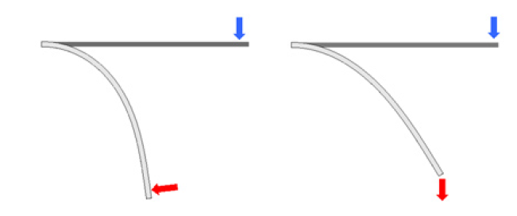
Table of Contents
Assembly of Abaqus/Standard subroutines
Documentation websites
FEM formulation for C3D8/C3D8T element
The UEL subroutine
Solving mechanical field: Linear geometry
Solving mechanical field: Nonlinear geometry
Solving heat transfer field
Solving hydrogen diffusion field
Solving phase field damage field
Step by step tutorial
Example on the 3D notched plate
Nonlinear geometry
Linear geometry

Slide 3
Note:
This PPT contains advanced FEM theory and deep understanding of how Abaqus solvers work
It mainly serves as documentations for anyone who wishes to understand and use the UEL subroutine

Slide 4
Crystal plasticity slip model

Slide 5
What is a slip model?

Slide 6
Documentation websites

Slide 7
What is a hardening model?
*PHYSICAL CONSTANTS - SIMULIA User Assistance 2025
UMAT - SIMULIA User Assistance 2025
UMATHT - SIMULIA User Assistance 2024
UEL - SIMULIA User Assistance 2025
HETVAL - SIMULIA User Assistance 2025
Uncoupled Heat Transfer Analysis - SIMULIA User Assistance 2025
Fully Coupled Thermal-Stress Analysis - SIMULIA User Assistance 2025
User-Defined Elements - SIMULIA User Assistance 2025
Conventions - SIMULIA User Assistance 2025
Initial Condition Types - SIMULIA User Assistance 2025

Slide 8
CAE model building

Slide 9
Indenter – Analytic or Discrete Grid?

Slide 10

Nguyen Xuan Binh, Junhe Lian*
Aalto University, Finland
Corresponding author: junhe.lian@aalto.fi

